Slide 1
How Habits and Genetics may Induce Risk for Diabetes
Anna Maria Thum

Slide 2
Abstract
For this analysis the Diabetes dataset 2019 from https://www.kaggle.com/tigganeha4/diabetes-dataset-2019 was used.
The main part of this project is to predict if a person has diabetes or not, as well as how a habits and genetics (like gender, regular intake of medicine, habit of smoking…) correlate.
After the data was cleaned (more about data cleaning on slide 5), the method heatmap from seaborn was used to visualise the correlations and for the diabetes prediction decision trees were used.

Slide 3
Motivation
As diabetes affects worldwide more and more people worldwide, with China having currently the highest number of diabetics, this presentation deals with different factors, that may increase ones risk of having or getting diabetes. Diabetes can lead to serious health complications, such as strokes, cardiovascular disease and is under the top then leading causes of death worldwide.
This issue might be for everyone, struggeling with this illness or trying to avoiding this problem, helpful.

Slide 4
Dataset(s)
This dataset was gathered by Neha Prerna Tigga and Dr. Shruti Garg of the Department of Computer Science and Engineering, BIT Mesra. It can be found under https://www.kaggle.com/tigganeha4/diabetes-dataset-2019.
The dataset consists of 952 samples and 18 variables. The observations are binary (diabetic, gender, smoking, …), numeric (pregnancies, sleep, BMI, …) and grouped (age: less than 40, 50-59,… or time of physical activity).

Slide 5
Data Preparation and Cleaning
As preparation for the analysis the data was modified as followed:
Drop all NA values with .dropna()
In column “Age” values varied between “yes”, “no” and “ no”. To get a binary result “ no” was changed to “no”. Similar to that were in column “BPLevel” (Blood Pressure Level” values “High”, “high”, “normal”, “normal “, “Low” and “low”. These values were grouped to either “high”, “normal” or “low”.
In “Regular Medicine” there were “yes”, “no” and “o”. As “o” could not be interpreted, they were dropped. Same in “Pregnancies” as “high”, “normal” and “low” could not be interpreted as numbers and were deleted.

Slide 6
Data Preparation and Cleaning
As preparation for the analysis the data was modified as followed:
Whole columns where deleted as they were almost everywhere 0, or could not be explained.
As all values where of datatype object, it was not possible to perform correlations or decision trees. So dummy variables where introduced.
The remaing data were split into training and testing set (67% of the data for training with n = 599, the remaining 33% for testing with n = 296)

Slide 7
Research Question(s)
Questions to be answered in this project:
How do different factors influence the risk for having diabetes? What are the interactions between them?
Computation of the risk one might be affected by diabetes and how well can the risk of having or getting diabetes be predicted from the dataset?
What is your research question you aim to answer using the dataset? Be sure the research question is well defined (see project description for details).

Slide 8
Methods
At first the dataset was inspected to find out, for example how diabetes is distributed between the gender or ages. Here the correlation between each factor was visualised with a correlation heatmap.
To predict the chances for diabetes the data was split in 67% training and 33% test set. After that the machine learning process decision tree was fitted to the training set and checked with the test set.

Slide 9
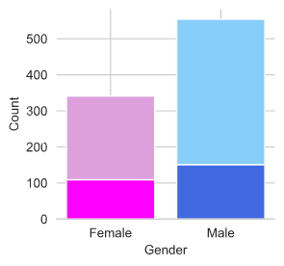
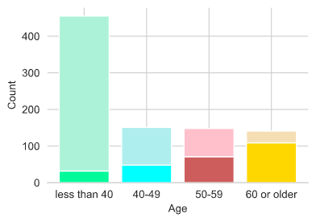
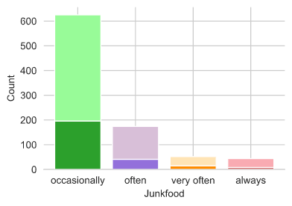
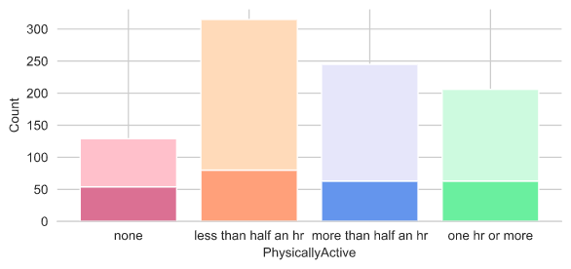
Findings: Diabetes Distribution by different factors

Slide 10
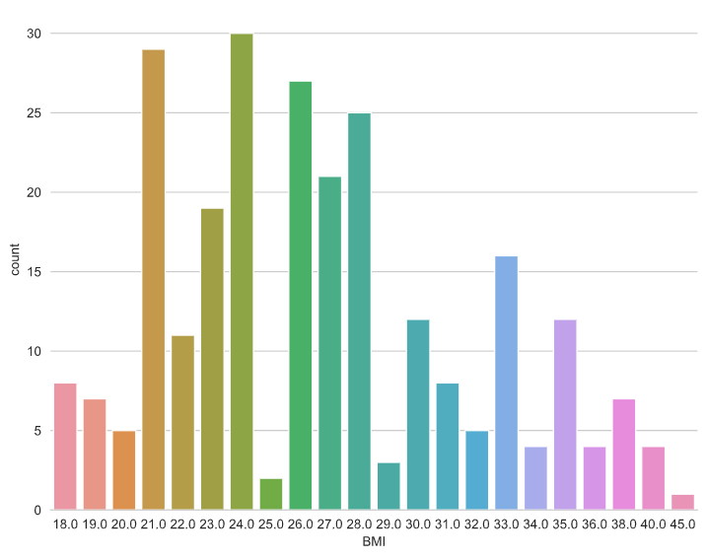
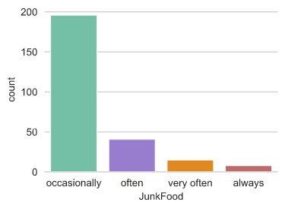
Findings

Slide 11
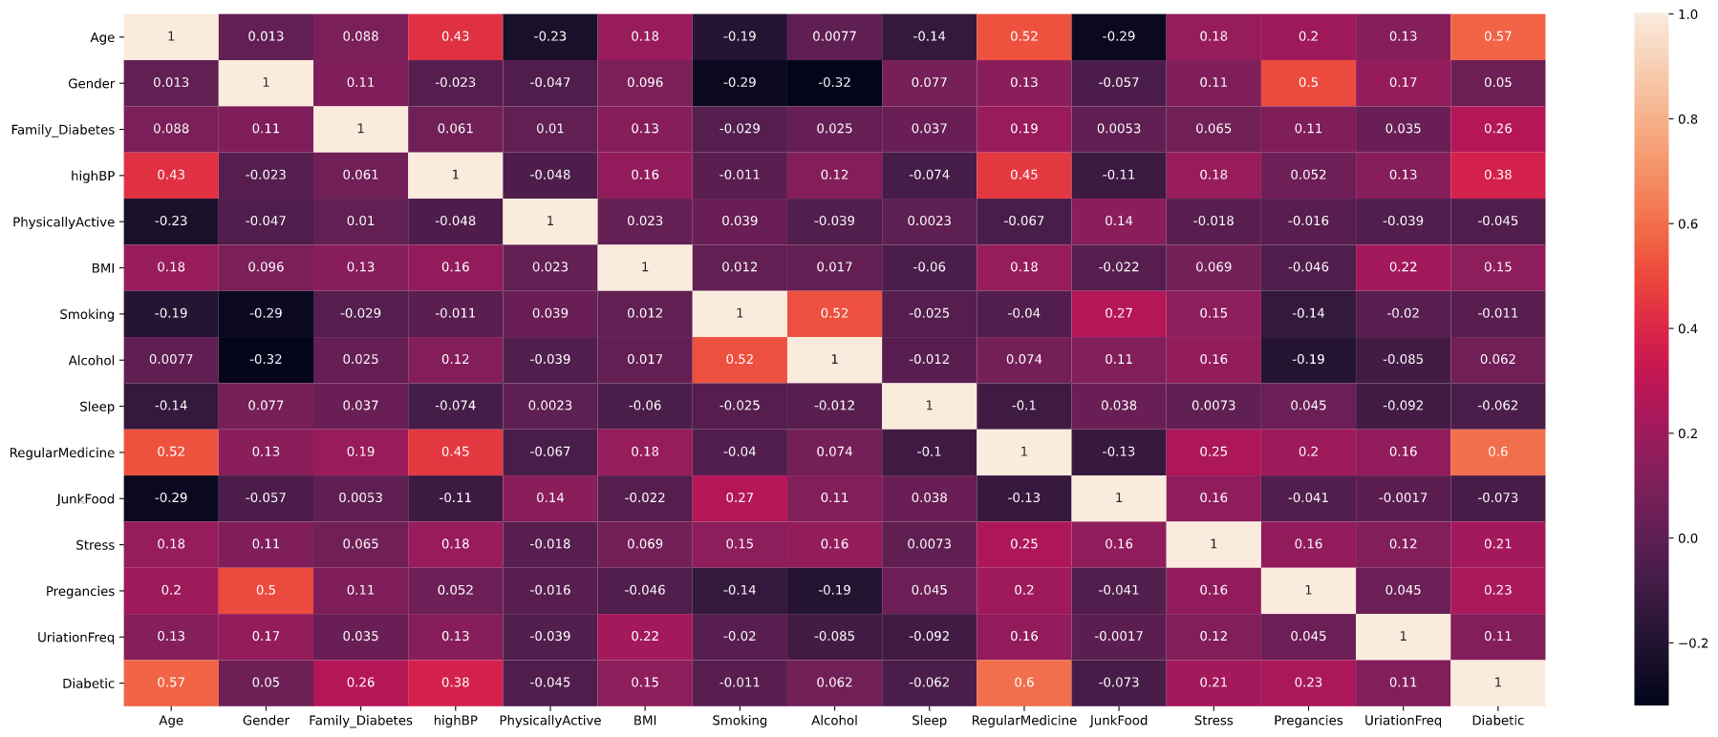
Findings

Slide 12
Findings
<Feel free to replicate this slide to show multiple findings>
Present your findings. Include at least one visualization in your presentation (feel free to include more). The visualization should be honest, accessible, and elegant for a general audience.
You need not come to a definitive conclusion, but you need to say how your findings relate back to your research question.

Slide 13
Limitations
If applicable, describe limitations to your findings. For example, you might note that these results were true for British Premier league players but may not be applicable to other leagues because of differences in league structures.
Or you may note that your data has inherent limitations. For example, you may not have access to the number of Twitter followers per users so you assumed all users are equally influential. If you had the number of followers, you could weight the impact of their tweet’s sentiment by their influence (# of followers).

Slide 14
Conclusions
Report your overall conclusions, preferably a conclusion per research question

Slide 15
Acknowledgements
Where did you get your data? Did you use other informal analysis to inform your work? Did you get feedback on your work by friends or colleagues? Etc. If you had no one give you feedback and you collected the data yourself, say so.

Slide 16
References
If applicable, report any references you used in your work. For example, you may have used a research paper from X to help guide your analysis. You should cite that work here. If you did all the work on your own, please state this.
https://www.statista.com/statistics/271464/percentage-of-diabetics-worldwide/

